Slide 1
Event Ticket Booking
Team 02

Slide 2
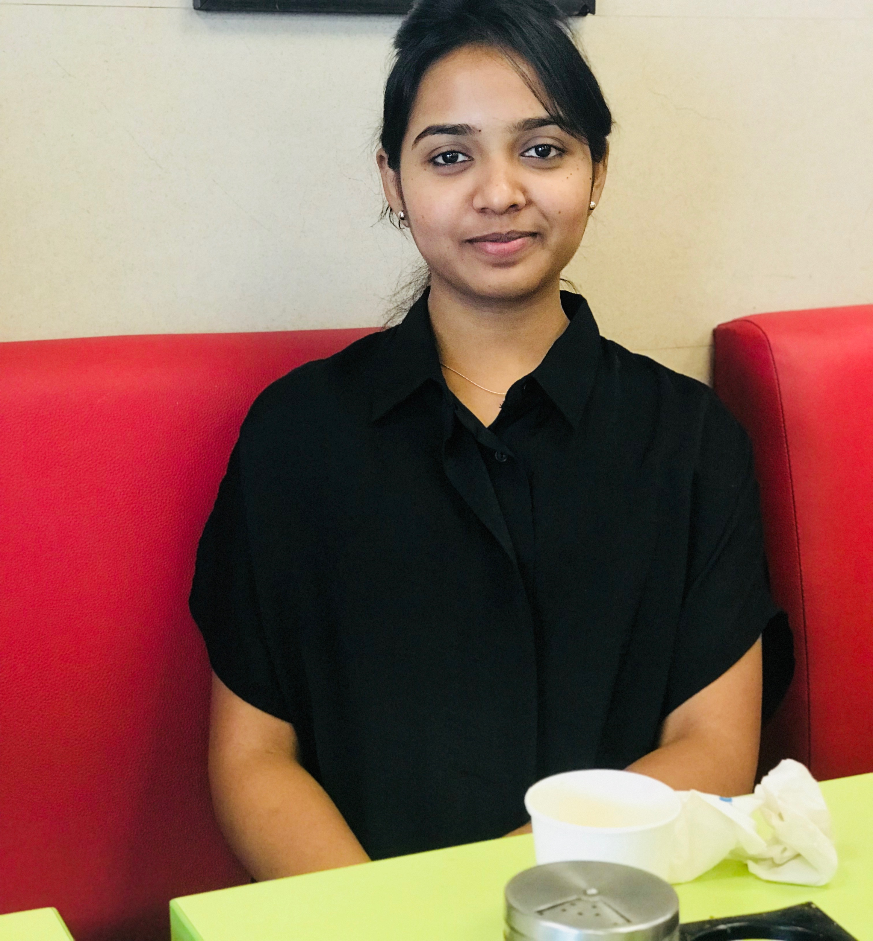
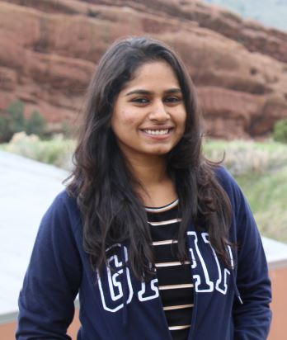
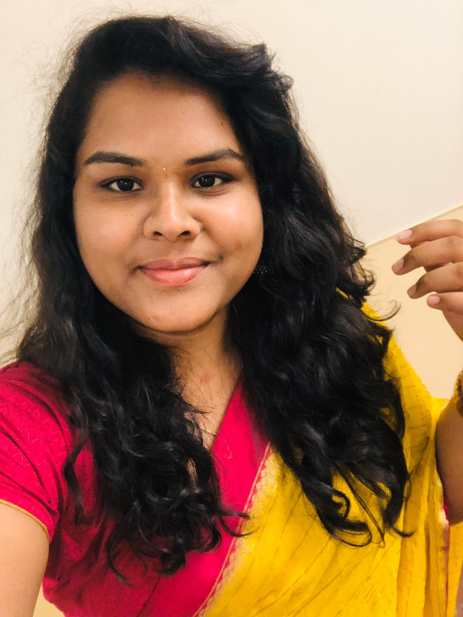
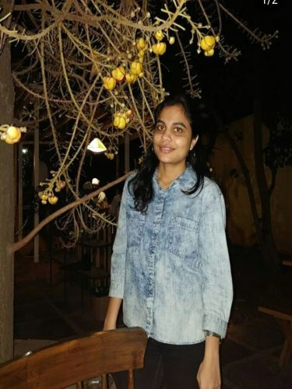
Team Members
Sravya Katpally
Sneha Madhavaram
Vinusha Sandadi
Sai Sri Dachepalli

Slide 3
Introduction To Problem
The conventional ways would need users to be physically present at a location to book tickets.
Users are only allowed to book tickets in a specific time slot.
Users typically won’t have access to see future events or time of the events.
Vinusha

Slide 4
Proposed Solution
Our application removes most of the problems caused by traditional way of booking tickets.
This application allows users to book online from anywhere and at anytime provided the user has an active internet connection.
The users can see all the future events and time of the events hence can plan and book efficiently.
Vinusha

Slide 5
Features and Completion Status
Feature | Status
Booking ticket | Completed
Confirming the booking | Completed
Adding event by admin | Completed
Deleting event by admin | Completed
Sending confirmation mail | Inprogress
Vinusha

Slide 6
Mobile Backend Services
Admin - Sign up | Completed
Admin - Login | Completed
User - Sign up | Completed
User - Login | Completed
Vinusha

Slide 7
Backend Services
Used Back4App for storing data.
A cloud database used to persist data of users registered, tickets and ticket information
Persist the history of the events added.
Vinusha

Slide 8
API’s Used for this Project
Android API - version 6.0
Genymotion - Version 3.0.2
Emulator device - Google Nexus 6, version - 5.0, API21
Device layout size 1440x2560
Sneha

Slide 9
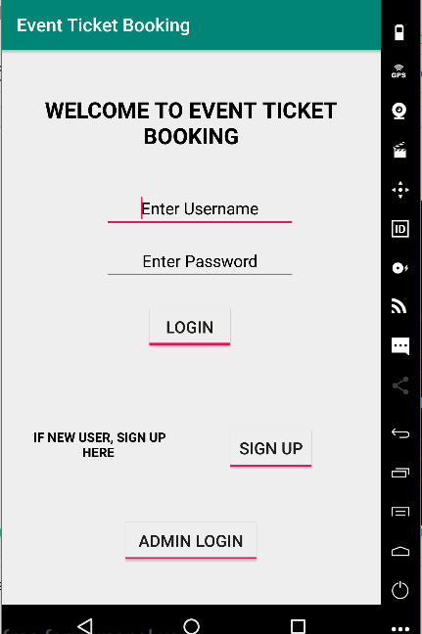
Main Page
Sneha

Slide 10
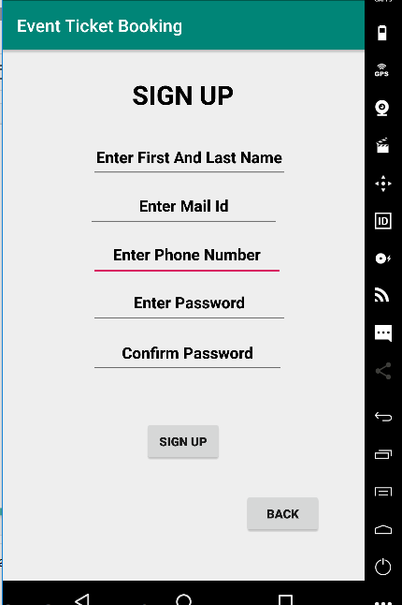
Sign Up Page
Sneha

Slide 11
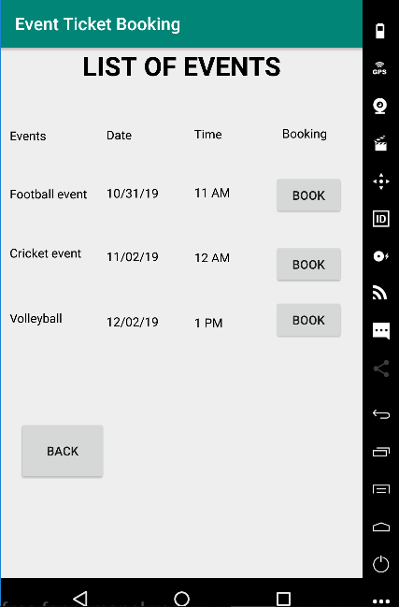
Event List Page
Sneha

Slide 12
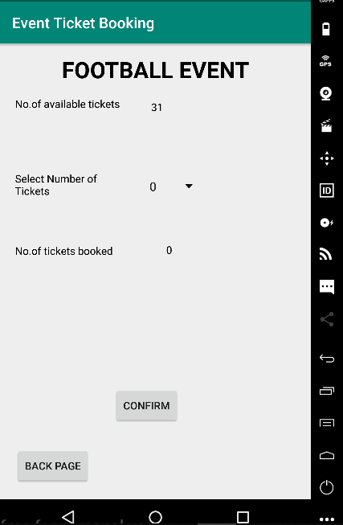
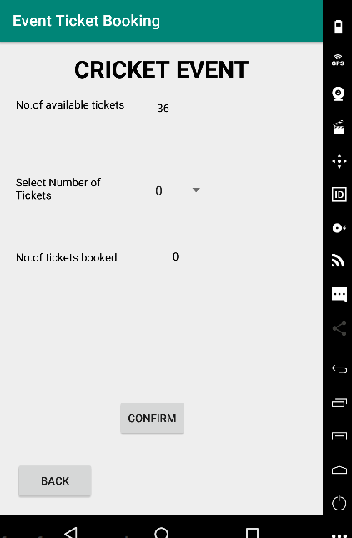
Events Ticket Booking Pages
Sneha

Slide 13
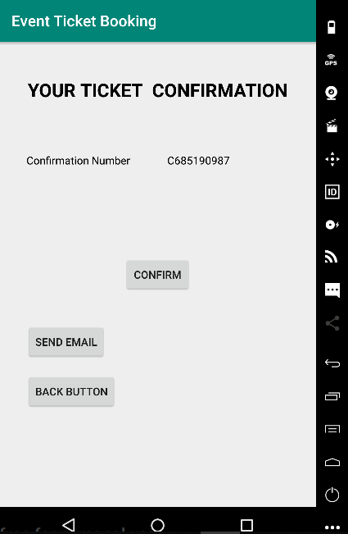
Confirmation Page
Sneha

Slide 14
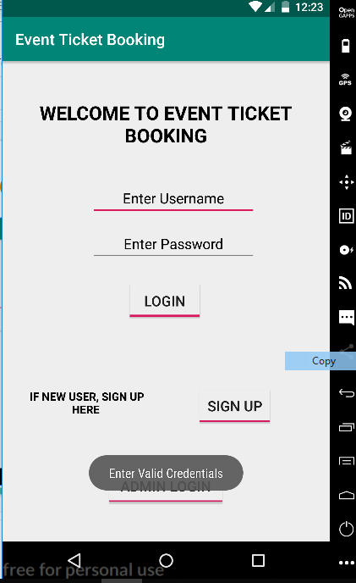
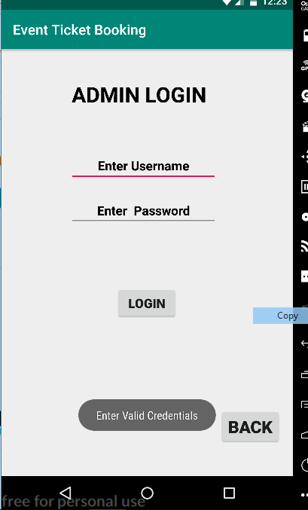
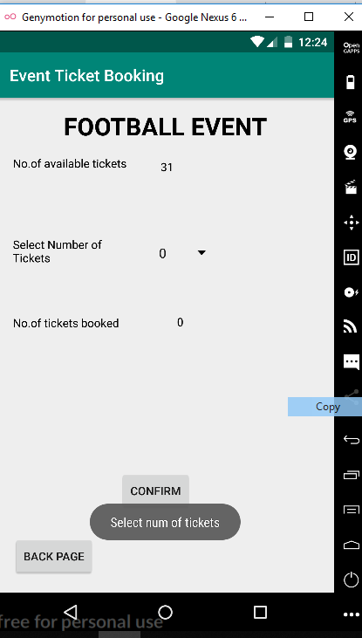
Error Messages
Sneha

Slide 15
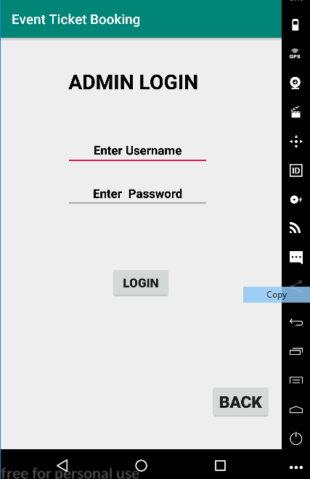
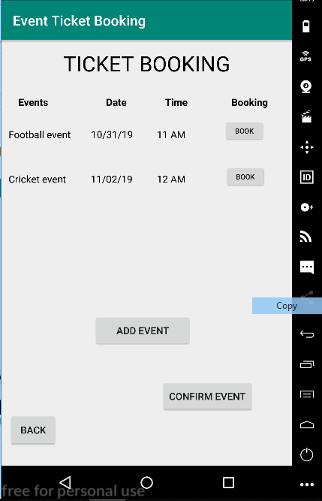
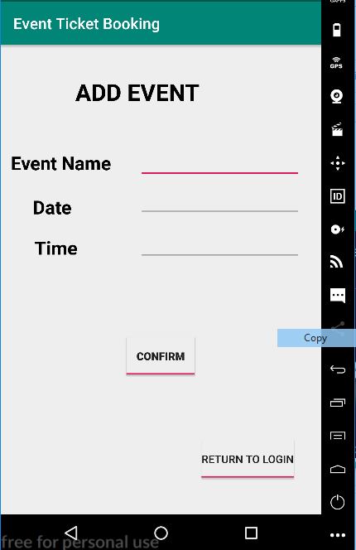
Admin Side Pages
Sai sri

Slide 16
Problems Faced
Understanding and implementing Back4App
Storing the new events data into the database
Adding new events in admin page
Retrieving data which was stored.
Sai Sri

Slide 17
Future Improvements
Sending event confirmation mail to the registered email address
Adding more details related to event
Sending a mail to registered users when a new event gets added
Sai Sri

Slide 18
References
https://www.back4app.com/docs/platform/get-started/parse-sdk
https://stackoverflow.com/questions/3624280/how-to-use-sharedpreferences-in-android-to-store-fetch-and-edit-values
https://www.tutorialspoint.com/
Sai Sri

Slide 19
Demo
Sravya

Slide 20
Conclusion
Even though this application would not replace the traditional methods completely, this project would eliminate most of the tedious tasks and is highly reliable, not only customers but also the organizations using this.
With that being said, moving into the present online era people prefer booking tickets at their ease rather than physically going to a location for making their purchase.
Sai Sri

Slide 21


Slide 22
Thank You!!!!

